Slide 1
Economic Development in South Seattle
Substantive Saturday Session – July 25, 2020
(John Stafford)

Slide 2
Bold Structural Change; Not Just Incremental Reform
We Face 5 Crises
Public Health (Pandemic)
Economic Recession
Budget Crisis in Olympia
Climate Change
Racial Justice
Campaign Priorities
Avoid Austerity Approach to Balancing State Budget
New Source of Progressive Revenue
Address Climate Change: High Impact/Low Cost Programs
Address the Challenge of Racial Justice: Focus on Societal Equity

Slide 3
Agenda
The Problem
Framework
Policy Responses
Themes

Slide 4
How Can We Promote Economic Growth in South Seattle?
A Good Question…
…And A Troubling Question?
It is imperative to implement strategies that will generate economic growth in South Seattle in order to address major income disparities.
It is concerning to tolerate enormous differences in all manner of societal well-being based on geography and ethnicity, and then ask how the ensuing discrepancies can be remedied with a Band-Aid approach to economic development.

Slide 5
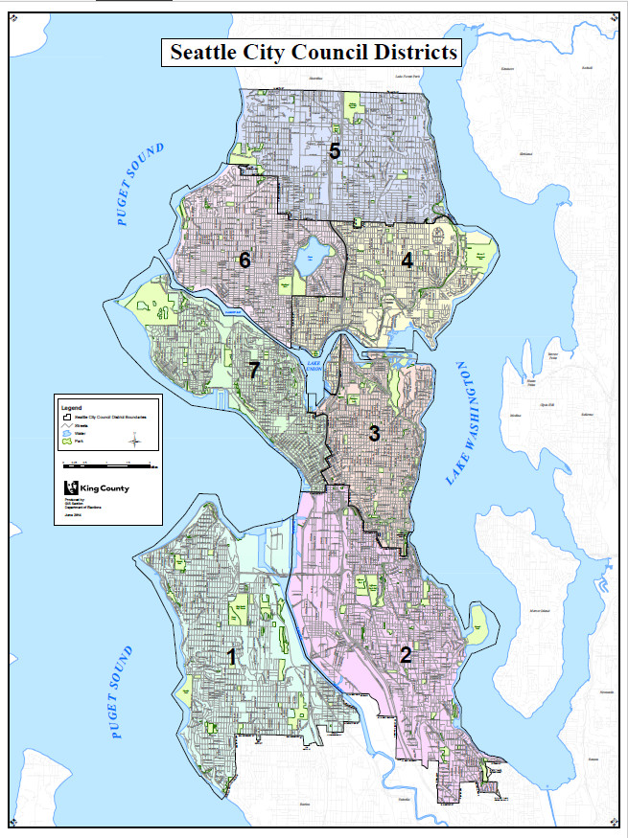

Slide 6
Seattle Neighborhood Data (2017)
 | REGION 1 | REGION 2 | REGION 3 | REGION 4 | REGION 5 | REGION 6 | REGION 7
REGION | WEST SEATTLE | SOUTHEAST SEATTLE | CENTRAL AREA | NORTHEAST SEATTLE | NORTH SEATTLE | NORTHWEST SEATTLE | PIONEER SQUARE
WHITE % | 67 | 29 | 68 | 71 | 67 | 82 | 71
BLACK % | 7 | 21 | 9 | 2 | 6 | 1 | 4
ASIAN % | 9 | 33 | 10 | 16 | 14 | 7 | 13
HISPANIC % | 9 | 9 | 6 | 4 | 7 | 5 | 6
OTHER % | 8 | 8 | 7 | 7 | 9 | 5 | 6
TOTAL % | 100 | 100 | 100 | 100 | 100 | 100 | 100
AVERAGE HOUSEHOLD INCOME | 81.4 | 63.5 | 89.4 | 85.4 | 81.5 | 98.7 | 90.0
UNEMPLOY-MENT RATE | 4.8 | 7.5 | 3.6 | 5.3 | 4.8 | 3.5 | 4.2
POVERTY RATE | 10.1 | 18.9 | 12.3 | 17.5 | 12.3 | 7.5 | 9.9

Slide 7
Additional Select Data
Seattle Public Schools: Free and Reduced Lunches By Race (2018)
African-American 83%
Caucasian 8%
Seattle Public Schools: 8th Grade Smarter Balanced Test Proficiency (2018)
Black = 30% Math and 35% Reading
White = 74% Math and 83% Reading
U.S. Median Income by Race (2017)
$40,258 Black
$68,145 White
U.S. Incarceration Rates by Race (2016)
Black = 1,408 per 1,000
White = 275 per 1,000
Sources: Seattle Public Schools Website; U.S. Census Bureau; U.S. Department of Justice

Slide 8
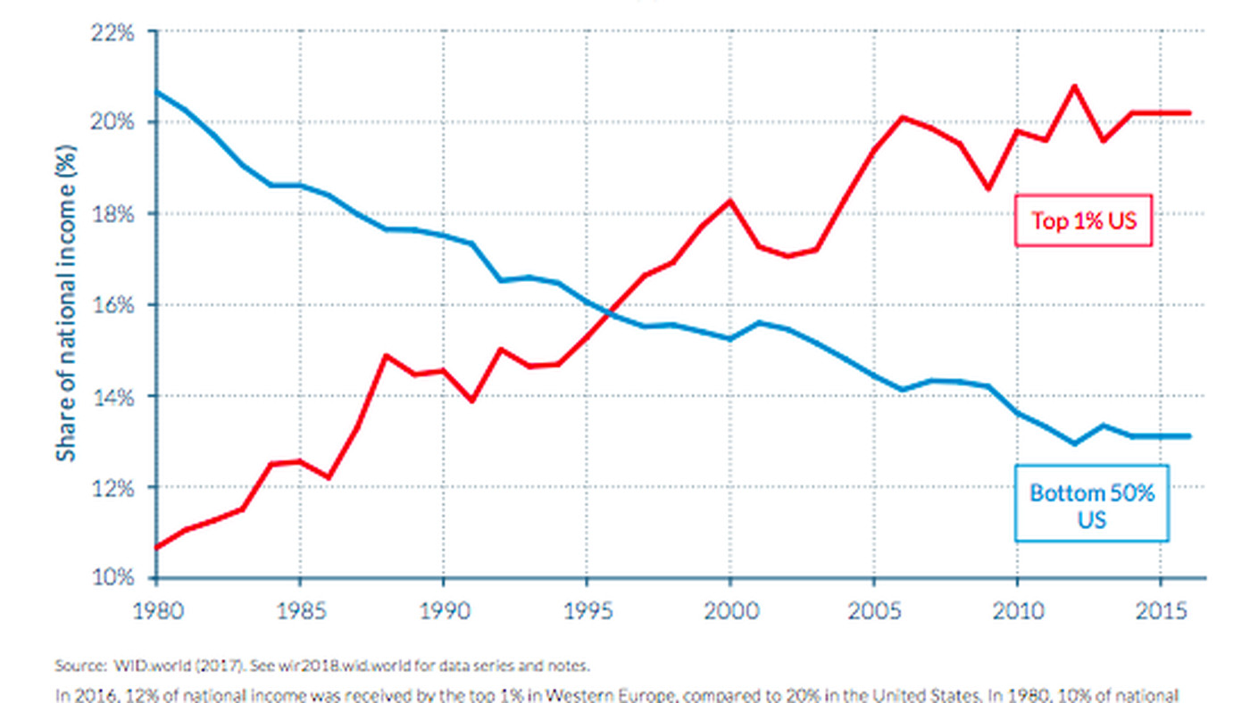
UNITED STATES: INCOME INEQUALITY OVER TIME

Slide 9
Change in Income Inequality in U.S. Over Time

Slide 10
Agenda
The Problem
Framework
Policy Responses
Themes

Slide 11
ECONOMIC DEVELOPMENT POLICY AREAS
RESOURCE REDISTRIBUTION
STRATEGIC
INVESTMENT
PROGRESSIVE POLICY
ORGANIZATIONS: COMMUNITY COHESION
PROGRESSIVE TAX REFORM
SOUND TRANSIT
AFFIRMATIVE ACTION
ETHIOPIAN COMMUNITY CENTER
INCREMENTAL IMPROVEMENTS
STRUCTURAL CHANGE

Slide 12
Economic Development Objectives
Economic Security
More Financial Stability, Less Homelessness, More Consumer Spending, Etc.
More Jobs
Greater Career Opportunity
Education is Key
Higher Wages
More Community Cohesion
More Family Stability
Less Crime
Greater Public Investment in Community
More Business Location in Community
Note: Importance of Unified Strategy, Planning, and Integration of Different Levels of Government
MULTIFACTED, SYMBIOTIC,
VIRTUOUS CIRCLE

Slide 13
Agenda
The Problem and Its Positioning
Framework
Policy Responses
Themes

Slide 14
Financially Redistributive
FEDERAL TAXATION
MORE PROGRESSIVE
EARNED INCOME TAX CREDIT
STATE TAXATION
TRANSITION FROM MOST REGRESSIVE TAX SYSTEM IN COUNTRY TO MORE PROGRESSIVE SYSTEM
CHANGE CORPORATE TAX TO TAX ON PROFITS
LOCAL TAXATION
TAXING LARGE CORPORATIONS FOR HOUSING
EDUCATION
COMMUNITY INVESTMENT SCHOOLS
2 YEARS FREE COLLEGE (SEATTLE PROMISE)
BUT NEEDS-BASED
WASHINGTON COLLEGE GRANT
WAGES
ONGOING INCREASES TO MINIMUM WAGE
HEALTH CARE
UNIVERSAL HEALTH CARE
SOCIAL SAFETY NET
WELFARE (TANF)
FOSTER CARE
SUBSIDIZED DAY CARE
UNEMPLOYMENT BENEFITS
JOB TRAINING AND JOB PLACEMENT PROGRAMS
FREE SICK AND SAFE LEAVE
BABY BONDS (COREY BOOKER)
UNDOCUMENTED IMMIGRANT FUND
FORECLOSURE AND EVICTION RELIEF
ZONING
ALLOWING INCREASED DENSITY IN SINGLE-FAMILY LOTS (E.G., ADUS AND DADUS)
HALA – REQUIRING DEVELOPERS TO SET ASIDE AFFORDABLE HOUSING UNITS
ELIMINTATING SINGLE FAMILY ZONING
HOUSING
PUBLIC INVESTMENT IN AFFORDABLE HOUSING
PUBLIC INVESTMENT IN HOMELESSNESS
RENT CONTROL
OREGON MODEL

Slide 15
Seattle High Schools: Free and Reduced Lunch Versus SAT
SAT SCORES: SCHOOL VS. STATE
PERCENT OF STUDENTS ON FREE AND REDUCED LUNCHES
Sources: Seattle Public Schools Website; GreatSchools.Org; Note: State Average SAT = 1067

Slide 16
My Proposal: Community Investment Schools
2 Tiers of Schools Within School Districts: “Normal” and “Community Investment”
“Community Investment” Status Triggered by Statistical Thresholds
e.g. High Percent Free and Reduced Lunch Students, Etc.
“Community Investment” Schools Receive Significantly Higher Per Pupil Investment than “Normal” Schools
20% Premium Pay (Teachers, Administrators)
Lower Class Sizes
Increased Wraparound Services (e.g., Counsellors)
Advanced Placement and International Baccalaureate Programs
MAKES THE STATEMENT:
HUGE DIFFERENCES IN SCHOOLS BASED ON SOCIO-ECONOMIC DIFFERENCES WILL NOT BE TOLERATED

Slide 17
Washington State: Tax Policy
REGRESSIVITY (PERCENT OF INCOME PAID IN STATE AND LOCAL TAXES BY LOWEST 20%-EARNERS)
IMPACT
Minimum Wage Earner ($15/Hour) In South Seattle Pays in Tax:
At 17.8% = $5,340
At 11.2% = $3,360
Difference = $2,000/Year
Sources: Washington State Office of Financial Management; Institute for Tax and Economic Policy, 2018

Slide 18
From 1995 to 2016: Washington Dropped from 11th to 30th

Slide 19
State Legislature 2021: Revenue Proposal (FRANK CHOPP PROPOSAL)
Three New Progressive Taxes
Capital Gains Tax
Payroll Tax
Tax on High Income Earners
Deals with Three Problems
More Taxation to Restore Safety Net
Deal with Budget Deficit Without Having to Resort to Austerity
Address Regressivity Problem With Tax Code
Total Value = $2BB/Year

Slide 20
Strategic Investment
Transportation Infrastructure Investment
E.G., I-405 and SR 167 Infrastructure
Parks, Libraries, Community Centers, Arts Facilities, etc.
Sound Transit
Internet as a Public Utility
Green New Deal Programs
E.G., Clean Energy Retrofits
Summer Jobs Programs
Corporate Investment Programs
Myriad Government Loan and Grant Programs – Access to Startup Capital
IDAs, IDBs, State Loan Guarantees, Federal Small Business Administration Loans, Federal Reserve Community and Reinvestment Act, Housing and Urban Development Grants, Microloans
Manage/Eliminate Predatory Lending
Opportunity Zones (OZs): Economically-distressed communities where investments are eligible for preferential tax treatment
Other Tax Incentive Programs
Tax Abatement, Tax Increment Financing
State Business Marketing Programs
To Attract Outside Businesses to State
Land Banks
Local Underutilized Land Development Agencies

Slide 21
KING COUNTY EQUITY NOW
Maximize Use of Underutilized Public Land
Decommissioned Fire Station 6 on 23rd & Yesler to become William Grose Center for Enterprise.
Seattle Housing Authority Operations Site on MLK & Dearborn to become affordable housing.
Paramount Nursing Home: Recently acquired by Washington State, to revert to Black-Ownership.
Vacant Sound Transit Lot on MLK & S. Angeline St. to become Youth Achievement Center.
Keiro Block Ownership Transition
Halt Predatory Development
Halt development at Yesler Terrace.
Halt the WA State Dept. of Commerce's corrupt Priority Development Area proposal for the Seattle Vocational Institute (“SVI”).
Halt development at the King County Records Site project on 13th & Yesler
Establish $1BB Anti-Gentrification, Land Acquisition Fund to Help Black Community Acquire Property in the Central Area
Access to Capital, Technical Assistance and Displacement Mitigation
Redistribute $180 Million from the Seattle Police Department Budget and Invest at Least $50 Million from the SPD Budget Back into the Black Community

Slide 22
Progressive Policy
AFFIRMATIVE ACTION
UNION GROWTH
INCREASE COLLECTIVE BARGAINING POWER OF WORKERS
LOCAL CONTENT/PREVAILING WAGE RULES
POLICING
FOCUS FUNDING AWAY FROM POLICING AND TOWARD COMMUNITIY INVESTMENT
TRAINING AGAINST BIAS
COMMUNITY POLICING MODEL
HAVING POLICE REFLECT THEIR COMMUNITIES
CRIMINAL JUSTICE REFORM
DIVERSION COURTS
MINIMIZE YOUTH DETENTION
REDUCED BAIL AND REDUCED LEGAL FINANCIAL OBLIGATIONS
INCREASED INVESTMENT IN REHABILITATION, REENTRY AND PAROLE
COMMONSENSE GUN CONTROL MEASURES
VOTING OUTREACH
PRE-REGISTRATION, AUTOMATIC VOTER REGISTRATION, SAME-DAY REGISTRATION
VOTING RIGHTS ACT
EDUCATION POLICY
CULTURALLY RELEVANT CURRICULUM
WRAPAROUND SERVICES
DECOUPLING GRADUATION FROM TESTING
ENSURING EQUITY IN DISCIPLINE
THE TRADES AS A FOCUS OF K-12 EDUCATION
TRANSIT INVESTMENTS IN LOWER-INCOME COMMUNITIES
TRANSIT ORIENTED DEVELOPMENT
PARK LOCATION, LIBRARY LOCATION, COMMUNITY CENTER PLACEMENT
TARGETED FUNDING FOR THE ARTS (TO ATTRACT INVESTMENT)
STATE BANK
HEALTH CARE
COMMUNITY HEALTH CARE CLINICS
CAP THE COST OF INSULIN
ELIMINATE MORTGAGE DEDUCTION FOR HOMEOWNERSHIP
TENANT EVICTITON PROTECTIONS AND FORECLOSURE PROTECTIONS AND LANDLORD PROTECTION
UNIVERSAL BASIC INCOME
ANTI-DISCRIMINATION IN HIRING

Slide 23
Organizational Support – Societal Cohesion
LOCAL CHAMBERS OF COMMERCE
BEACON HILL MERCHANTS ASSOCIATION
ROTARY AND KIWANIS CLUB
YMCA
YOUTH AND FAMILY SERVICES
SOCIAL PROGRAMS
BEFORE AND AFTER SCHOOL PROGRAMS
TUTORING PROGRAMS
BIG BROTHER/BIG SISTER PROGRAMS
RAINIER SCHOLARS
AMERICORPS
NON-PROFITS
PLANNED PARENTHOOD
ARTS IN MOTION
CHARITABLE ORGANIZATIONS
UNITED WAY
COMMUNITY CENTERS
FILIPINO COMMUNITY CENTER
ETHIOPIAN COMMUNITY CENTER
ASSOCIATIONS AND COALITIONS
SOUTHEAST EFFECTIVE DEVELOPMENT
DEPARTMENT OF EMERGENCY SERVICES
TABOR 100
OFFICE OF MINORITY AND WOMEN’S BUSINESS ENTERPRISES
CIVIC ORGANIZATIONS
COALITION OF IMMIGRANT, REFUGEE AND COMMUNITIES OF COLOR
AFRICATOWN
PRIDE
EAST AFRICAN COMMUNITY SERVICES
ETC.
ORGANIZATIONS THAT FOCUS ON FINANCIAL AND TECHNOLOGICAL LITERACY

Slide 24
ECONOMIC DEVELOPMENT POLICY AREAS
RESOURCE REDISTRIBUTION
STRATEGIC
INVESTMENT
PROGRESSIVE POLICY
ORGANIZATIONS: COMMUNITY COHESION
PROGRESSIVE TAX REFORM
SOUND TRANSIT
AFFIRMATIVE ACTION
ETHIOPIAN COMMUNITY CENTER
INCREMENTAL IMPROVEMENTS
STRUCTURAL CHANGE

Slide 25
Agenda
The Problem and Its Positioning
Framework
Policy Responses
Themes

Slide 26
Themes
Economic development is a critical challenge for the 37th Legislative District
Cannot tolerate massive inequities year over year
Must avoid shooting ourselves in the foot (e.g., regressive taxation)
There is not a magic solution for economic development
It requires simultaneous progress on many fronts – a complicated mosaic
It is important to ask the correct questions:
Promote economic development, and…
Address underlying inequalities
Structural changes are more important than gimmicks
Economic development programs can/should support other societal objectives
Planning and vision must be integrated
Multi-pronged, multi-polity, multi-stakeholder involvement is key

Slide 27
My Priorities
Improvement in K-12 Education
-- Community Investment Schools to address societal inequities in education
Free, Needs-Based Two Years of Community College in Washington State
-- Seattle Promise Program (But Needs Based)
Tax Reform – New Progressive Taxation in Washington State
Expanded Safety Net
E.G., TANF, Unemployment Benefits, Public Investment in Housing, Public Investment in Homelessness, Etc.
Subsidized Day Care (Especially Important During Pandemic)
Infrastructure Investments That Provide Jobs
-- Sound Transit
-- Internet as Public Utility
-- Transit Oriented Development
-- Green New Deal Programs
Affirmative Action Programs (I-1776)
Local Content/Prevailing Wage Requirements
Criminal Justice System Reforms That Support Diversion, Rehabilitation and Re-Entry
Vibrant Civil Society
Underutilized Land Development
Tax-Advantaged Enterprise Zones

