Slide 1
Health Care Reform In Washington State
Substantive Saturday Session
July 11, 2020
(John Stafford)

Slide 2
Bold Structural Change; Not Just Incremental Reform
We Face 5 Crises
Public Health (Pandemic)
Economic Recession
Budget Crisis in Olympia
Racial Justice
Climate Change
Campaign Priorities
Avoid Austerity Approach to Balancing State Budget
Protect the Poor and Vulnerable
No Universal Programs
Restructure State Operations
New Source of Progressive Revenue
Aggressively Address Climate Change
Address the Challenge of Racial Justice

Slide 3
Agenda
The Health Care Crisis
Washington State
Policy Update and Options

Slide 4
HEALTH CARE MODELS
FEE-FOR SERVICE
(NO INSURANCE)
TWO-PRONGED:
FEE FOR SERVICE
AND
INSURANCE
(FOR CATASTROPHIC)
EMPLOYER-BASED
MANDATES FOR CITIZENS AND INSURERS
MULTI-PAYER
SINGLE-PAYER
NATIONALIZED
PARAGUAY
SINGAPORE
JAPAN
DENMARK
GERMANY
CANADA
ENGLAND

Slide 5
U.S. HEALTH CARE SYSTEM
FEE FOR SERVICE
EMPLOYER-BASED
MANDATES FOR CITIZENS AND INSURERS
SINGLE-PAYER
GOVERNMENT-OWNED
UNINSURED
MOST COMMON FORM
AFFORDABLE CARE ACT
MEDICARE
MEDICAID
VETERANS ADMINISTRATION
U.S. HAS FIVE DIFFERENT SYSTEMS

Slide 6
INSURANCE COVERAGE LEVELS BY COUNTRY
COUNTRY AND INSURANCE COVERAGE (%) | COVERAGE AND INSURANCE COVERAGE (%)
AUSTRALIA – 100% | SOUTH AFRICA – 100%
CANADA – 100% | SWEDEN – 100%
CZECH REPUBLIC – 100% | SWITZERLAND – 100%
DENMARK – 100% | UNITED KINGDOM – 100%
FINLAND – 100% | AUSTRIA – 99.9%
GREECE – 100% | FRANCE – 99.9%
HUNGARY – 100% | GERMANY – 99.9%
ICELAND – 100% | NETHERLANDS – 99.9%
IRELAND – 100% | SPAIN – 99.9%
ISRAEL – 100% | TURKEY – 99.5%
ITALY – 100% | BELGIUM – 99%
JAPAN – 100% | LUXEMBOURG – 100%
SOUTH KOREA – 100% | SLOVAKIA – 97.2%
NEW ZEALAND – 100% | CHILE – 94.3%
NORWAY – 100% | ESTONIA – 94.1%
PORTUGAL – 100% | POLAND – 91.5%
SLOVENIA – 100% | UNITED STATES – 91.2%

Slide 7
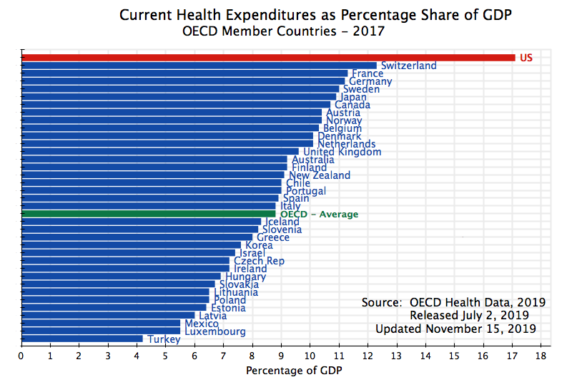

Slide 8
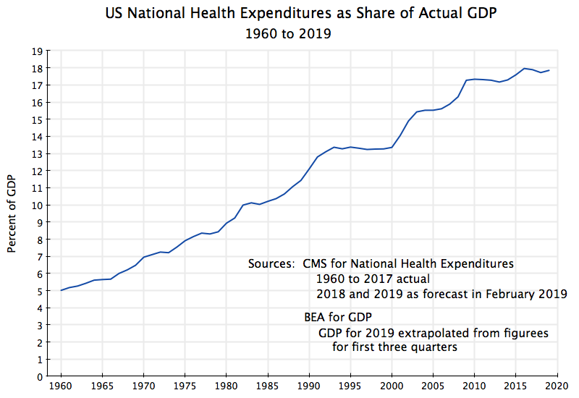
Health Care Costs Are Rising

Slide 9
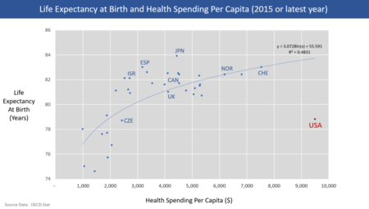
U.S. Healthcare Costs Versus GDP

Slide 10
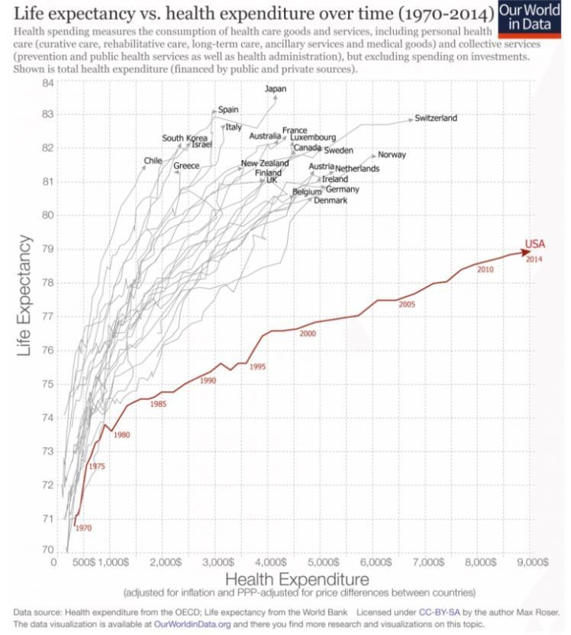
Health Care Expenditures Versus Life Expectancy

Slide 11
Reasons For High U.S. Cost (Partial List)
Societal Factors
Aging Demographic, High Obesity Levels, Gun Violence, High Incarcerated Population
New Pharmaceutical Benefit (Medicare Part D), No Bulk Purchasing, Patents, Technological Sophistication, Limited Cross-Border Imports of Vaccines, Cosmetic Surgeries, Lawsuits -- Litigious Society and High Jury Awards, Excessive Licensing Requirements in Profession
5 Health Care Models Operating Concurrently
High Administrative Costs
Lack of Standardization/Automation of Medical Records
Fraud
Federal and State Programs That Share Payment Responsibility (e.g., Medicaid)
Costs Associated with Employer Based Model
Portability
Cobra
No Incentive For Lifecycle Care (E.G. Billboards That Advocate Against Drinking)
High Uninsured Leads to Added Costs
Emergency Room Care

Slide 12
Reasons for High U.S. Cost (2/2)
Profit At Multiple Levels
Price Gouging
Companies Pursuing Addiction (E.G. Opiods)
Lack of Incentives to Manage Cost
Consumer: “Insurance Will Pay For It”
Company Buyer: “This is Between the Consumer and Our Health Care Provider”
Insurance Company: “This Will Be Handled Via Charging the Company Via Premiums”
Physician: “I Will Be Able To Do These Procedures and Bill the Insurance Company.” “I May Choose to Perform Extra Procedures to Protect Myself From Lawsuits”
Asymmetric Information
Related Questions
Should Health Care Be a For-Profit Industry?
Is Health Care a Fundamental Right?
Equity: Race and Ethnic Divides, Class Divides, Urban/Rural Divide
Zip Code and Life Expectancy
The Internet, Telemedicine, and Equity
Efforts to Repeal the ACA
The System is Resistant to Change – It Has Momentum

Slide 13
Agenda
The Health Care Crisis
Washington State
Policy Update and Options

Slide 14
States By Coverage Levels (Non-Medicaid Expansion States)
State | Employer | Non-Group | Medicaid | Medicare | Military | Uninsured | Total
Wisconsin | 57% | 5% | 17% | 15% | 1% | 6% | 100%
California | 47% | 7% | 26% | 11% | 1% | 7% | 100%
Kansas | 55% | 6% | 14% | 14% | 2% | 9% | 100%
Missouri | 52% | 6% | 15% | 16% | 1% | 9% | 100%
South Dakota | 52% | 8% | 13% | 15% | 2% | 9% | 100%
Alabama | 47% | 5% | 20% | 16% | 2% | 10% | 100%
South Carolina | 45% | 6% | 19% | 16% | 2% | 10% | 100%
North Carolina | 47% | 6% | 18% | 15% | 3% | 11% | 100%
Wyoming | 55% | 7% | 10% | 15% | 2% | 11% | 100%
Mississippi | 43% | 5% | 23% | 14% | 2% | 12% | 100%
Florida | 40% | 10% | 18% | 17% | 2% | 13% | 100%
Georgia | 49% | 6% | 17% | 12% | 2% | 14% | 100%
Oklahoma | 46% | 6% | 18% | 15% | 2% | 14% | 100%
Texas | 47% | 6% | 17% | 10% | 2% | 18% | 100%

Slide 15
Medicaid Expansion States
State | Employer | Non-Group | Medicaid | Medicare | Military | Uninsured | Total
District of Columbia | 53% | 7% | 28% | 8% | 1% | 3% | 100%
Massachusetts | 55% | 6% | 23% | 13% | 1% | 3% | 100%
Hawaii | 55% | 5% | 17% | 15% | 5% | 4% | 100%
Minnesota | 57% | 6% | 18% | 14% | 1% | 4% | 100%
Rhode Island | 52% | 5% | 23% | 14% | 1% | 4% | 100%
Vermont | 49% | 6% | 23% | 16% | 1% | 4% | 100%
Connecticut | 54% | 5% | 21% | 14% | 1% | 5% | 100%
Iowa | 54% | 5% | 19% | 15% | 1% | 5% | 100%
Michigan | 51% | 5% | 22% | 15% | 1% | 5% | 100%
New Hampshire | 57% | 5% | 14% | 17% | 1% | 5% | 100%
New York | 49% | 6% | 26% | 13% | <.01 | 5% | 100%
Delaware | 50% | 5% | 21% | 17% | 1% | 6% | 100%
Kentucky | 47% | 4% | 26% | 15% | 2% | 6% | 100%
Maryland | 56% | 5% | 19% | 13% | 2% | 6% | 100%
Ohio | 52% | 5% | 21% | 15% | 1% | 6% | 100%
Pennsylvania | 52% | 5% | 20% | 16% | 1% | 6% | 100%
West Virginia | 44% | 3% | 26% | 19% | 1% | 6% | 100%
Illinois | 54% | 6% | 19% | 13% | 1% | 7% | 100%
New Jersey | 57% | 6% | 17% | 13% | <.01 | 7% | 100%
Oregon | 48% | 7% | 22% | 16% | 1% | 7% | 100%
Washington | 52% | 6% | 21% | 13% | 2% | 7% | 100%
Arkansas | 42% | 6% | 27% | 16% | 1% | 8% | 100%
Colorado | 52% | 7% | 18% | 12% | 2% | 8% | 100%
Indiana | 54% | 5% | 18% | 15% | 1% | 8% | 100%
Louisiana | 42% | 5% | 29% | 13% | 2% | 8% | 100%
Maine | 48% | 6% | 18% | 17% | 2% | 8% | 100%
Montana | 44% | 7% | 21% | 17% | 2% | 8% | 100%
Nebraska | 55% | 7% | 13% | 14% | 2% | 8% | 100%
North Dakota | 57% | 8% | 12% | 13% | 2% | 8% | 100%
New Mexico | 37% | 4% | 33% | 15% | 2% | 9% | 100%
Utah | 61% | 9% | 10% | 10% | 1% | 9% | 100%
Virginia | 54% | 6% | 12% | 14% | 4% | 9% | 100%
Tennessee | 47% | 6% | 21% | 15% | 2% | 10% | 100%
Arizona | 44% | 5% | 22% | 16% | 1% | 11% | 100%
Idaho | 47% | 9% | 17% | 15% | 2% | 11% | 100%
Nevada | 48% | 5% | 19% | 14% | 2% | 11% | 100%
Alaska | 48% | 4% | 21% | 9% | 5% | 12% | 100%

Slide 16
Health Exchanges and Public Options
ACA State Level Exchanges
State Level Public Options
California: Covered California
Colorado: Connect for Health Colorado
Connecticut: Access Health CT
District of Columbia: DC Health Link
Idaho: Health Idaho
Maryland: Maryland Health Connection
Massachusetts: Health Connector
Minnesota: MN Sure
Nevada: Nevada Health Link
New York: New York State of Health
Rhode Island: Health Source RI
Vermont: Vermont Heatlh Connect
Washington: Washington Health Plan Finder
Implemented
Washington State (“Cascade Care”)
Considering
Oregon
California
Nevada
Wyoming
Colorado
New Mexico
Minnesota
Iowa
Missouri
Wisconsin
Maryland
New Jersey
Delaware
Connecticut
Maine
New Hampshire

Slide 17
Mental Health Care in Washington State
Centralized
Decentralized
Eastern State (Spokane County)
Western State (Pierce County)
Community Health Centers

Slide 18
Top U.S. Healthcare Systems
STATE | U.S. NEWS AND WORLD REPORT (2019) | COMMONWEALTH (2018) | MONEY RATES (2020)
Hawaii | 1 | 1 | 23
Massachusetts | 2 | 2 | 1
Connecticut | 3 | 9 | 2
Washington | 4 | 7 | 22
Rhode Island | 5 | 12 | 7
New Jersey | 6 | 25 | 24
California | 7 | 14 | 31
Maryland | 8 | 20 | 13
Utah | 9 | 5 | 35
Minnesota | 10 | 3 | 8
Vermont | 11 | 4 | 5
Colorado | 12 | 10 | 20
New York | 13 | 18 | 30
Wisconsin | 14 | 8 | 21
Delaware | 15 | 22 | 33

Slide 19
Agenda
The Health Care Crisis
Washington State
Policy Update and Options

Slide 20
Health Care Issues in Washington State
Pandemic-Related
Other
Increasing/Decreasing Mental Health Transition to Community Model
Size of Public Option During Pandemic
Expanding ACA to Increase Coverage Levels
Maintaining Employer Health Care Coverage Levels During Pandemic (e.g., PPP)
Ensuring Regular Health Care Needs are Being Addressed During Pandemic
Testing, Tracing and Quarantines and Level of Opening
Summer Job Program
The $100 Million Fund to Protect Undocumented Immigrants
Examine Move to Single-Payer
Study Funded in Budget
Impact of Recent U.S. Supreme Court Decisions
E.G., Religious Employers Not Required to Provide Contraceptive Care
Insulin
Bill to Limit Costs (Passed)
Bill to Establish Central Purchasing Authority (Did not Pass)
Etc.
Ban on Flavored Vaping (Did Not Pass)
Mandatory Vaccination (Passed)
MMR and the Personal and Philosophical Objection
Pharmacy Tourism (Did Not Pass)
Comprehensive Sex Education in K-12 (Passed)

Slide 21
What About Single Payer at State Level?
Whole Washington: Working for Single Payer in Washington State
Thus Far, Not Impressive Record in U.S.
Vermont (Green Mountain Care), Massachusetts (MassCare), Colorado (Colorado Care Initiative – Defeated), Oregon (Healthcare for all Task Force), California (Health California for All Commission)
Issues
Is This The Right Approach?
Is Now the Right Time?
Should This Start at the State Level or the National Level?
Transition is Difficult – Where Does This Stand As A Priority?

Slide 22
Paul Krugman: Comments on Single-Payer
“So if it were up to me, I’d talk about improving the A.C.A., not ripping it up and starting over…I have nothing against single-payer; it’s what I’d support if we were starting fresh. But we aren’t: Getting there from here would be very hard, and might not accomplish much more than a more modest, incremental approach. Even idealists need to set priorities, and Medicare-for-all shouldn’t be at the top of the list.” – 8/7/17
“Does pointing out the possibility of incremental progress mean giving up on a truly universal system? No. By all means let’s make something more ambitious, such as Medicare for all, a long-term goal. But this goal shouldn’t stand in the way of policies that would immediately benefit millions of Americans, and save thousands of lives. – 1/13/20

Slide 23
Next Steps for Health Care Reform in Washington State
Meet Health Care Demands of Pandemic
Capacity: Hospital, Ventilator, PPE,
Testing Capacity, Contact Tracing, Quarantines
Safe-Start Phased Reopening
Health Care Issues In School Reopenings
$100 Million Fund for Undocumented Immigrants?
Incremental Changes Elsewhere
Insulin Task Force
Vaccine Tourism
Etc.
Structural Reform
Accelerate Transition to Community-Based Health Care Model?
Begin Planning for Transition to Single Payer System?

