Slide 1
The Climate Change Crisis
Substantive Saturday Session
July 4, 2020
(John Stafford)

Slide 2
Bold Structural Change; Not Just Incremental Reform
We Face 5 Crises
Public Health (Pandemic)
Economic Recession
Budget Crisis in Olympia
Racial Justice
Climate Change
Campaign Priorities
Avoid Austerity Approach to Balancing State Budget
Protect the Poor and Vulnerable
No Universal Programs
Restructure State Operations
New Source of Progressive Revenue
Aggressively Address Climate Change
Address the Challenge of Racial Justice

Slide 3
Agenda
The Climate Change Crisis
The Response
Washington State Policy
The 2021 Legislative Session
Themes

Slide 4
CLIMATE CHANGE IMPACTS (Selective)
NATURAL WORLD
HUMAN SOCIETY
More Extreme Weather Events (Drought, Hurricanes, Cyclones)
Increase in Wildfires
Wetland Loss and Mangrove Loss, With More Flooding
Change in Precipitation Patterns
Decline in Hydropower
Loss of Global Ice Sheets
Rise in Sea Levels – More Uninhabitable Terrain
Desertification of Land (from Heat and Salination)
Soil Erosion, Coastal Erosion
Decline in Air Quality and Water Quality (Saltwater Intrusion, Algae Blooms, Invasive Species)
Increase in Ocean Acidification
Decline in Biodiversity (Animal, Plant, Fish, Oceanic Coral and Vegetation)
Decrease In Soil Moisture, Increased Soil Erosion
Changes in Crop Viability
Livestock Death
Decline in Natural Systems’ Ability to Absorb Carbon
Change in Spatial Patterns of Plants, Animals, Marine life
Increased Human Health Risks – Disease Prevalence, Cardio-Respiratory Risk, Diaarheal Prevalence, Morbidity Levels, Etc.
New Disease Vectors
Allergenic Polins
Changes in Crop Viability and Yields
Decrease in Food Supply and Increased Malnutrition Risks
Changes in Agriculture, Fisheries , Forestry, Etc.
Viability of Human Settlements
Increased Push Migration
Demographic Shifts
Increased Power Outages
Increased Geopolitical Instability
Increased Conflict
Increased Struggle Over Water Rights
Risk of Country Elimination (from Sea Level Rise)
Huge Implications for Economic Development

Slide 5
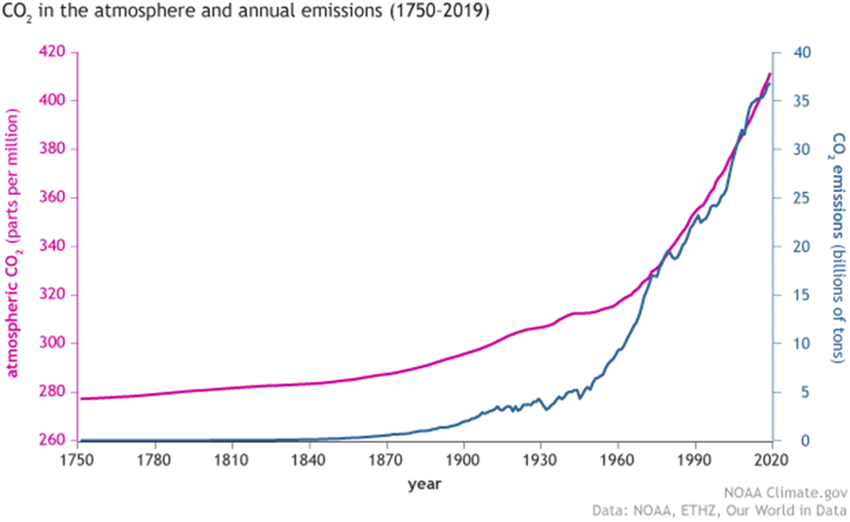
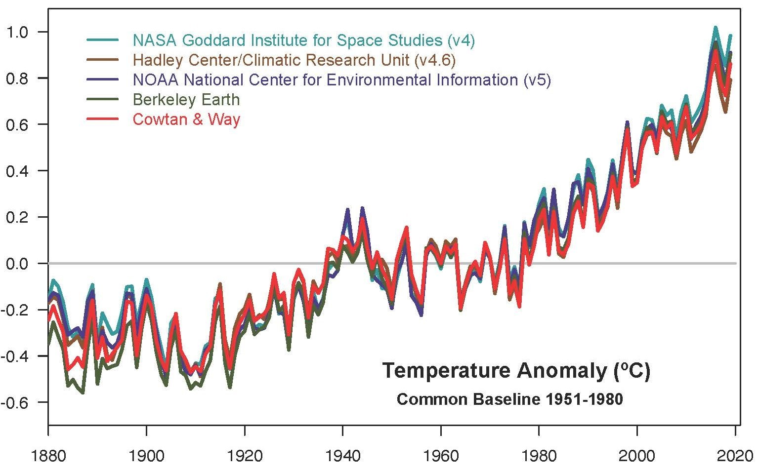
Carbon Dioxide Levels and Global Temperatures Over Time

Slide 6
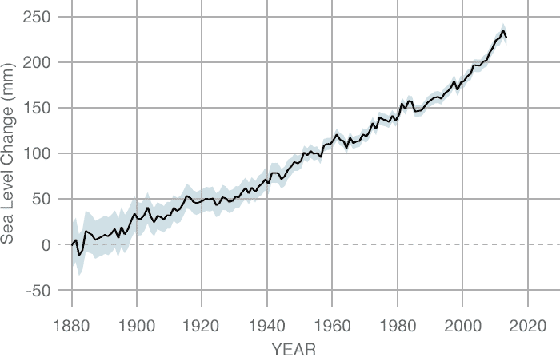
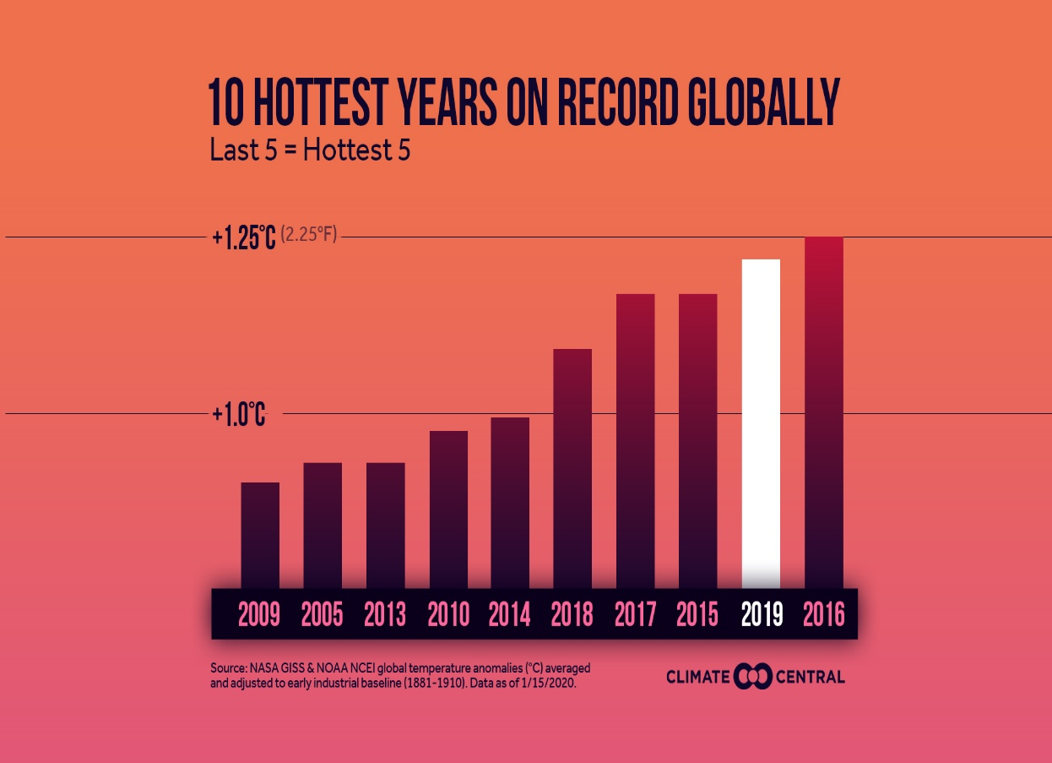
Climate Change is Now
Sea Level Rise (Ground Data)
Global Temperatures
Source: CSIRO

Slide 7
Quotes (President of 73rd UN General Assembly)
Maria Fernanda Espinosa Garces, President of the General Assembly, warned the Assembly that “we are the last generation that can prevent irreparable damage to our planet”. Worldwide, thousands of students are mobilizing around the message that we do not have a planet B and there is no future without a planet, she said, calling for their pleas not to fall on deaf ears. Against that backdrop, she stressed the need to act. “Eleven years is all we have ahead of us to change our direction,” she said, citing the findings of the latest Intergovernmental Panel on Climate Change report. “2019 must be the year of climate action at all levels,” she stressed. – UN Press Release, March 28, 2019
“There is no documented historic precedent for the scale of changes required.” – IPCC, 2019

Slide 8
Controversial?
“Multiple studies published in peer-reviewed scientific journals show that 97 percent or more of actively publishing climate scientists agree: Climate-warming trends over the past century are extremely likely due to human activities. In addition, most of the leading scientific organizations worldwide have issued public statements endorsing this position.” -- NASA
Climate Scientists Who Believe Global Warming is Anthropogenic
Comments
“The 2010s were another lost decade on climate change.” – James Temple, MIT Technology Review (12/24/19).
Is 97% not a high enough level of consensus to warrant concerted global action?
Addressing climate change is valuable for many reasons.

Slide 9
Agenda
The Climate Change Crisis
The Response
Washington State Policy
The 2021 Legislative Session
Themes

Slide 10
Perspectives
Liberal
Alarming
Obama
“The Trends are Terrifying.” -- 2016
Paris Climate Agreement
Clean Power Plan
Vehicle MPG Standards
Biden
"It's almost like denying gravity now. ... The willing suspension of disbelief can only be sustained for so long." -- 2015
Inslee
“We are the first generation to feel the sting of climate change and we are the last generation that can do something about it. And we have got one shot ― that’s the next administration.” -- 2019
Trump
“The concept of climate change was created by and for the Chinese to make U.S. manufacturing non-competitive.” -- 2012
Withdraw U.S. from Participation in Paris Climate Agreement, Repeal Clean Power Plan, Repeal MPG Standards
Offshore Leases, Drilling in National Monuments, Gulf of Mexico Safety Restriction Relaxation, ANWR
Reduce Expertise in EPA
ExxonMobil
On February 1st [2019] the company announced annual results, declaring itself on track for ambitious growth. By 2025, oil and gas production will be 25% higher than in 2017. – The Economist 2/9/19

Slide 11
DIMENSIONS TO ADDRESS CLIMATE CRISIS
MITIGATION
VIA REDUCTION IN ENERGY DEMAND
MITIGATION VIA CHANGE IN TECHNOLOGY
MITIGATION
VIA SOURCE OF ENERGY
MITIGATION VIA CARBON REMOVAL
RESILIENCE AND ADAPTATION
DECISION-MAKING AND GOVERNANCE
POPULATION
NEW ECONOMIC SYSTEM
LESS CONSUMERISM
TRANSIT
LOCAL FOOD
LESS GLOBAL TRADE
LED LIGHTBULBS
ENERGY-EFFICIENT APPLIANCES
DOUBLE-PANED GLASS
INSULATION
COW DIGESTION PILLS
BUILDING CODES AND RETROFITS
FROM FOSSIL FUEL TO RENEWABLES
NATURAL
OCEANS
TREES
ARTIFICIAL
GEO-ENGINEERING
COMMUNITY RELOCATION
CULTIVARS AND PESTICIDES
CHANGE PLANTING SEASONS
NEW FISHING RIGHTS
NEW WATER RIGHTS
EARLY WARNING SYSTEMS
DISEASE SURVEILLANCE
COASTAL DESIGN
FLOOD CONTROL
FIREFIGHTING
GLOBAL DECISION-MAKING
CROSS-JURISDICTIONAL DECISION-MAKING
CROSS-SECTORAL DECISION-MAKING

Slide 12
Climate Change Concepts (Partial List)
Intersectionality – Land Use, Housing Design, Transit, TOD, Food Systems
Wholistic Thinking and Models for Change
Focusing on Systems and Not Carbon Emissions
Human Consciousness
Economic Systems
Green New Deal
New Ways of Planning for Human Activity
Cross-Jurisdictional
Cross-Functional
The Global North Versus Global South
Just Transition
Climate Justice
Intergenerational Compact
Booked for Extinction?
Compounding Phenomena
Scientific: Melting Ice Sheets Reduces Reflective Surfaces and Causes Sea Levels to Rise and Can Make Ocean More Acidic
Human: Climate Change Leads to Melting of Arctic Which Provides Opportunities for Oil and Gas Exploration
Geopolitical Forces and Fossil Fuel Incentives
China Belt and Road Initiative
Decline in Globalized Responses with Rise in Nationalism
Divides
Denial Versus Acceptance
Blue-Green
Rural-Urban Divide
Pollution Versus Esoterica Divide
Liberals Versus Conservatives
False Narrative: Economy Versus Environment
Keeping Fossil Fuels in the Ground
Other Fuels -- Controversial
Fracking Is Not A Bridge Solution
Hydropower
Nuclear Power
The Use of Carbon Offsets – Controversial
Sectoral Approach
Transportation, Electric Grid, Commercial

Slide 13
Agenda
The Crisis
The Response
Washington State Policy
The 2021 Legislative Session
Themes

Slide 14
Thoughts on Climate Change Policy
Washington State should be national leader in climate change policy
The abundance of hydro reduces our cost of climate policy
Climate Change should be a primary theme of every legislative session
There are synergies to a “Solid West Coast” of Climate Champions
Washington, Oregon, California, Hawaii, Province of British Columbia
It is useful to divide climate change policies into two categories: breakthrough and incremental

Slide 15
Ten Breakthrough Climate Change Policies (Best Practices)
INSTITUTE 100% RENEWABLE POWERED ELECTRIC GRID (Bill Passed, 2019)
MAKE COAL ILLEGAL FOR ELECTRICITY PRODUCTION (Bill Passed, 2019)
IMPLEMENT STATEWIDE PRICE ON CARBON (Introduced, Not Passed)
BAN INTERNAL COMBUSION ENGINES (Introduced, Not Passed)
INSTITUTE MANDATORY K-12 CLIMATE CHANGE CURRICULUM STATEWIDE (Introduced, Not Passed)
MAKE NEW FOSSIL FUEL INFRASTRUCTURE ILLEGAL (Partial Bill Introduced for Shorelines, Not Passed)
REQUIRE ALL PUBLIC FLEETS TO BE FULLY ELECTRIC
CREATE TAX-INCENTIVIZED GREEN ENERGY BUSINESS CLUSTER
DIVEST FROM FOSSIL FUEL COMPANIES
SUPPORT MASSIVE INVESTMENT IN RENEWABLE ENERGY

Slide 16
Interesting Bills/Resolutions (Sample)
National
New Jersey – Mandatory K-12 Climate Change Curriculum in Schools Statewide
Microsoft, Amazon, Others – Climate Reduction Programs
George Schulz and James Baker – Carbon Dividend Plan
Green New Deal
100% Renewable Energy Grid Required in Multiple States (Including Washington)
Washington State
Banning ICE (Not Yet Passed)
Zero Emission Vehicles (ZEV) Mandate
Rural Carbon Sequestration
Seattle Public Schools – Resolution for School District to Be Net Zero
Climate Pledge Arena

Slide 17
Agenda
The Climate Change Crisis
The Response
Washington State Policy
The 2021 Legislative Session
Themes

Slide 18
Principles
The 2021 Washington State Legislative Session will not have Climate Change as a Central Issue…
…But it must be a Central Issue.
Solution:
Manageable Number of High Impact, Low Cost Climate Change Bills

Slide 19
Climate Change Priorities for 2021 State Legislative Session
Clean Fuels Program: Lower Carbon Content in Transportation Fuels
Heal (Healthy Environment for All) Act: The Just Transition
Ban Sale of New Internal Combustion Engine Vehicles in 2030: The Future Now
Declare Climate Emergency in Washington State: Public Attention
Mandatory K-12 Climate Change Curriculum in K-12 Schools Statewide: 1MM Plus Young People Learning About Climate Change Everyday

Slide 20
Agenda
The Crisis
The Response
Washington State Policy
The 2021 Legislative Session
Themes

Slide 21
Themes
Climate Change is an Existential Emergency
Climate Change is Now
Climate Change is Time Sensitive
The Climate Change Battle is Not Being Won, Although Progress is Being Made
We Are a Negligent Country with Respect to Climate Change
It Is Time for a Massive Transformation in Our Response to Climate Change – The Defining Challenge of Our Time
There are Myriad Solutions in Many Realms
Everyone Needs to Be Involved – Education, Consciousness and Involvement are Key
There are Critical Bills That Need to be Passed in the 2021 Legislative Session

