Slide 1
George Floyd and the Black Lives Matter Protests: What is the Appropriate Policy Response?
Substantive Saturday
June 27, 2020
(John Stafford)

Slide 2
Bold Structural Change; Not Just Incremental Reform
We Face 5 Crises
Public Health (Pandemic)
Economic Recession
Budget Crisis in Olympia
Racial Justice
Climate Change
Campaign Priorities
Avoid Austerity Approach to Balancing State Budget
Protect the Poor and Vulnerable – No Universal Programs
Seek to Restructure State Operations
New Source of Progressive Revenue
Address Climate Change – High Impact/Low Cost Programs
Address the Challenge of Racial Justice – Focus on Societal Equity

Slide 3
Agenda
The Black Lives Matter Challenge
Options for Reform: Tactical
Options for Reform: Structural
Themes

Slide 4
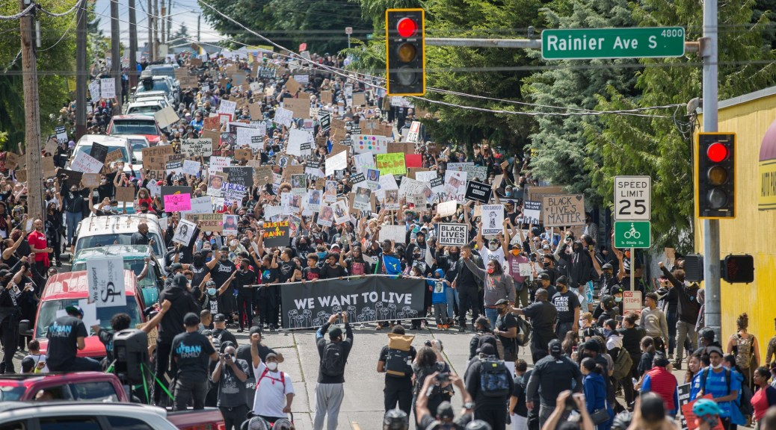
George Floyd Protest Marches

Slide 5
The Crisis
High Profile Police Shootings by White Officers of African-Americans
Treyvon Martin, Eric Garner, Michael Brown, Tamir Rice, Walter Scott, Alton Sterling, Philando Castile, Stephon Clark, Manuel Ellis, Breonna Taylor, Ahmaud Arbery, George Floyd (and many others)
Myriad Areas of Discriminatory Practices in Society
Health Care Access, The Pandemic, Restarting the Economy, Climate Change Impacts, Employment Opportunities, Education, Wages, etc.
Political Candidates Exploit Racial Fears
George H.W. Bush and Willie Horton
Bill Clinton and 3 Strikes
Donald Trump and “When the looting starts, the shooting starts.”
Etc.

Slide 6
The Nation’s History
1619: The Start of Slavery in North America
Slave Patrols
Civil War
Black Codes
Reconstruction
40 Acres and a Mule (Not Fulfilled)
Tilden/Hayes Compromise of 1877 Ends Reconstruction
The KKK, Lynchings and Backlash
Plessy Vs. Ferguson and Separate But Equal
The Birth of a Nation
Poll taxes, Redlining, Community Covenants, etc.
Civil Rights Era
The Age of Mass Incarceration – The New Jim Crow
Affordable Housing, Homelessness and Gentrification
Police Discrimination and Inappropriate Use of Lethal Force
Etc.
Housing and Homelessness
Other Minority Groups
REPRODUCING SYSTEMS OF RACIAL INJUSTICE

Slide 7
Intertwined Issues (Not Dealt with Today)
The Battle for U.S. Principles and Values
All Men Are Created Equal or White Supremacy
White Privilege
Patriarchy
Reparations
Hard Vs. Soft
Statues, Monuments, Parks, etc.
Curriculum and Textbooks
Howard Zinn: A People’s History of the United States
Ronald Takaki: A Different Mirror
Corporate Responsibility
Hiring/Promotion/Compensation
Brands (e.g., Aunt Jemima)
Controversial Figures: Colin Kaepernick
Protests and the Insurrection Act
Predictive Policing with Artificial Intelligence and Cameras
Other International Policing Models (e.g., Portugal, Switzerland, etc.)
Decriminalization of Drugs, Sex Work, Etc.
Gun Control
Linkages Between Movements for Equity: Black Lives Matter, BIPOC, LGBTQ, etc.
Impact on Police Recruiting/Hiring/Retention/Morale and Effectiveness

Slide 8
Agenda
The Black Lives Matter Challenge
Options for Reform: Tactical
Options for Reform: Structural
Themes

Slide 9
CONCEPTUAL OPTIONS FOR ADDRESSING CRISIS
NO CHANGE:
“LAW AND ORDER”
DEFUND THE POLICE
RESTRUCTURE/
REIMAGINE POLICING
ADDRESS UNDERLYING SOCIETAL INEQUITIES
CHANGE THE CAPITALIST SYSTEM
FOCUS ON CRACKING DOWN ON PROTESTORS
REDUCE POLICE BUDGETS BY 50%
CHANGE POLICE ROLES, POLICIES AND PRACTICES
REFORM CRIMINAL JUSTICE SYSTEM
DEAL WITH AREAS OF UNDERLYING SOCIETAL INEQUITY
CHANGE THE ECONOMIC SYSTEM WHICH GIVES RISE TO THE NEED FOR RACIST INSTITUTIONS
FOCUS OF MY CANDIDACY

Slide 10
Option 1: Status Quo – Maintain Law and Order
"They demand law and order. They may not say it, they may not be talking about it, but that's what they want. Some of them don't even know that's what they want, but that's what they want.“ – Donald Trump
The President tweeted on Saturday that if protesters breached the White House's fence, they would "have been greeted with the most vicious dogs, and most ominous weapons, I have ever seen.“

Slide 11
Option 2: Defund the Police (Arguing in Favor)
Enough. We can’t reform the police. The only way to diminish police violence is to reduce contact between the public and the police. There is not a single era in United States history in which the police were not a force of violence against black people. I’ve been advocating the abolition of the police for years. Regardless of your view on police power — whether you want to get rid of the police or simply to make them less violent — here’s an immediate demand we can all make: Cut the number of police in half and cut their budget in half. Fewer police officers equals fewer opportunities for them to brutalize and kill people. The idea is gaining traction in Minneapolis, Dallas, Los Angeles and other cities. – Mariame Kabe, “Yes, we mean literally abolish the police.” New York Times, 6/12/20.
“We’re asking cops to do too much in this country. Every societal failure, we put it off on the cops to solve. Not enough mental health funding, let the cops handle it.…Here in Dallas we got a loose dog problem; let’s have the cops chase loose dogs. Schools fail, let’s give it to the cops….Policing was never meant to solve all those problems.” -- Former Dallas Police Chief David Brown, 2016.

Slide 12
Option 2: Defund the Police (Arguing Against)
This will damage public safety and it will hurt the communities it is intended to help. – Numerous Analysts
“The suggestion of defunding police departments around the country, however, is the single most absurd idea we have heard. Proposals vary — some call for merely shifting a portion of police budgets to other programs, while others demand the actual elimination of police departments. Yes, there are bad cops, but the vast majority of more than 800,000 law enforcement officers are good, decent people doing a difficult and thankless job. – Santa Clara Valley Signal, June 8, 2020
Stephen Crawford, a research professor at George Washington University, points out that when the Baltimore police stepped back after the uproar over Freddie Gray’s death in 2015, crime rose and Baltimore’s homicide rate became the highest in the nation. “It is naïve to think that abolishing the police will radically reduce robbery, rape and murder, even if all the saved money is reallocated to better housing, schools, jobs and social services. Fixing these broader problems will take far more resources.” – Stephen Crawford

Slide 13
Option 3: Restructure the Police (Sample of Discussed Reforms)
Demilitarization/Technology
Ban transfer of U.S. military technology to local police (from Pentagon)
Ban flash bang devices, blast balls, rubber bullets, tear gas, etc.
Remove police officers from public schools
Unbundle Police Services
Mental health specialists and community service providers handle some segments of calls
Create two emergency lines – 911 and a mental health/social worker intervention line
Police Procedures
Ban chokeholds, eliminate no-name warrants, practice regular use of body cameras, require display of badge numbers, institute more restrictions on use of force (e.g., shooting at a moving vehicle)
Increased training: crisis intervention, de-escalation, implicit bias, etc.
Increased Oversight
Consent decrees, eliminate qualified (limited) liability
Community Oversight Committees (Civilian Review Boards), national registry of use of violence incidents
Increased Oversight (Continued)
Appropriate investigatory procedures (conducted with community oversight, family of victim involved, etc.)
Federal Regulation and Accountability
Unions
Weaken union protections of officers
Community members at contract negotiations
Ross Douthat: “…which makes it too hard to fire bad cops, too easy to rehire them, too difficult to sue them, too challenging to win a guilty verdict when they’re charged with an offense.”
Making officers personally accountable for misconduct settlements
New Policing Models
Community Policing
Having officers reflect the demographics of their communities
Investment
Added spending on social programs
Added spending on before and after school programs

Slide 14
Option 3: Restructure the Criminal Justice System (Sample of Discussed Reforms)
Sentencing Reforms
No Three Strikes Laws, Powder versus Crack Cocaine, Reduced Juvenille Sentences
Eliminate Bail
Diversion Programs
E.G., Drug Courts
Facilities
Don’t Build Youth Jail in Seattle
No Private Prisons
Rehabilitation Programs
Prison Rehabilitation and Education Programs, Work Release Programs, Fair Prison Labor Wages, Restorative Justice, Parole
Re-Entry Programs
Job Retraining, Ban the Box
Restore Felony Voting Rights

Slide 15
Major Actions Taken In Seattle
Promotion of Police Chief Carmen Best (2018)
I-940 (2018)
New Standard for Acceptable Use of Force by Police Officers
Consent Decree Between Seattle Police Department and Federal Government (2012)
Seattle Police Officers Guild Expelled from MLK Labor Council (2020)
Community Police Commission and Office of Police Accountability Created
Police Officers Removed from Seattle Public Schools (2020)
Black Lives Matter Calls for 50% Reduction in Police Budget (2020)
Mayor Jennifer Durkan Budget – 5% Reduction in Police Budge (2020)
City Council Member (and Community Group) Calls for Further Reductions (2020)
CHOP (Capital Hill Occupied Protest) and East Precinct Control (2020)
Federal Judges Bans Use of Pepper Spray, Tear Gas, etc. on Peaceful Protests (2020)

Slide 16
Agenda
The Black Lives Matter Challenge
Options for Reform: Tactical
Options for Reform: Structural
Themes

Slide 17
Societal Inequities
But, these [police reform] bills, if they pass as conceived, would basically punish the system’s soldiers without altering the system itself. These bills would make the officers the fall guy for their bad behavior while doing little to condemn or even address the savagery and voraciousness of the system that required their service. What he [King] was seeking, what we were seeking, at that point — quality education, decent, good-paying jobs, fair housing — would actually cost the nation something. That is what real justice looks like: equal access to possibility, success and safety. In this fight, our sights must be set high, our demands comprehensive. There is no glory in aiming small, in meekly pleading before power, to accepting crumbs on the floor when the bread is on the table.
But no one wants to talk about that, let alone deal with it, because to truly tackle these issues would deal in some way with wealth redistribution, and the mere mention of that concept throws the comfortable and the rich into a tizzy. So, we’ll ban some chokeholds. We’ll collect some new records and disclose others. We’ll put constraints on officers, requiring more training and exposing them to litigation. But just remember: These are not necessarily rogue officers. They are instruments of the system and manifestations of society. They are violent to black people because America is violent to black people. They oppress because America oppresses.
-- Charles Blow, NYT, 6/10/20

Slide 18
Data
Free and Reduced Lunches By Race in Seattle Public Schools (2018)
African-Americans 83%; Caucasian 8%
Smarter Balanced Test Proficiency in Math and Reading by Race – Seattle Public Schools, 8th Grade Students (2018)
Black = 30% and 35%
White = 74% and 83%
Median Income by Race (2017)
$40,258 Black
$68,145 White
U.S. Incarceration Rates by Race (2016)
1,408 per 1,000 Black versus 275 per 1,000 White
Sources: Seattle Public Schools Website; U.S. Census Bureau; U.S. Department of Justice

Slide 19
Addressing Societal Injustices
Must Address Underlying Sources of Injustice:
Universal Health Care (Single Payer Health Care System), Ongoing Increases to the Minimum Wage, Free Day Care, Robust Social Safety Net, Etc.
My Proposal: Community Investment Schools
Triggered by Statistical Thresholds (e.g. High Percent Free and Reduced Lunch Students, Etc.)
Four-Pronged Investment
20% Premium Pay (Teacher, Principal)
Lower Class Sizes
Increased Wraparound Services (e.g., Counsellors)
Advanced Placement and International Baccalaureate Programs
MAKE CLEAR: ENORMOUS SOCIO-ECONOMIC DIFFERENCES WILL BE ADDRESSED VIA DIFFERENTIAL PUBLIC SCHOOL INVESTMENT LEVELS

Slide 20
Agenda
The Black Lives Matter Challenge
Options for Reform: Tactical
Options for Reform: Structural
Themes

Slide 21
CONCEPTUAL OPTIONS FOR ADDRESSING CRISIS
NO CHANGE:
“LAW AND ORDER”
DEFUND THE POLICE
RESTRUCTURE/
REIMAGINE POLICING
ADDRESS UNDERLYING SOCIETAL INEQUITIES
CHANGE THE CAPITALIST SYSTEM
FOCUS ON CRACKING DOWN ON PROTESTORS
REDUCE POLICE BUDGETS BY 50%
CHANGE POLICE ROLES, POLICIES AND PRACTICES
REFORM CRIMINAL JUSTICE SYSTEM
DEAL WITH AREAS OF UNDERLYING SOCIETAL INEQUITY
CHANGE THE ECONOMIC SYSTEM WHICH GIVES RISE TO THE NEED FOR RACIST INSTITUTIONS
FOCUS OF MY CANDIDACY

Slide 22
Themes
This is an Important Moment
The Black Lives Matter Protests are Legitimate and Meaningful
They Bring Into Question Critical Questions About the Nation’s History and Its Future
The Protests and the Demands Represent a Long Term Challenge To Be Embraced; Not a Short Term Problem to Be Solved
In My View, Reforms Should Be A Combination of:
Restructuring The Police
Addressing the Underlying Structural Inequities that Give Rise to the Deep Injustices in American Society, Which In Turn Lead to Issues of Police Injustice
STRUCTURAL CHANGE; NOT JUST INCRMENTAL REFORM

