Slide 1
The Pending Budget Crisis in Olympia And What to Do About It
Substantive Saturday
June 20, 2020
(John Stafford)

Slide 2
Bold Structural Change; Not Just Incremental Reform
We Face 5 Crises
Public Health (Pandemic)
Economic Recession
Budget Crisis in Olympia
Climate Crisis
Racial Justice
Five Campaign Priorities
Restructure State Operations to Protect Public Health and Reduce Expenditures
Protect the Poor – Programs Must Not Be Universal
New Source of Progressive Revenue
Address Climate Change – High Impact/Low Cost Programs
Address the Challenge of Racial Justice and Equity

Slide 3
Agenda
Budget Crisis in Olympia
Conceptual Framework
Spending Cuts
Raising Taxes
Summary

Slide 4
Context
There is a Pending Budget Crisis in Olympia
Lower Revenues and Higher Expenses = Crisis
The State Operates on a Biennium Basis
2021 will be “Long Session” (105 Days) – To Create New State Budgets
2022 will be a “Short Session” (60 Days) – To Modify These Budgets
The State’s Fiscal Year Starts on July 1 of Each Year
Washington State Must Balance Its Budget
Cannot Deficit Spend
Washington State has a Democratic Trifecta
Control of Governorship, House and Senate

Slide 5
STATE GDP GROWTH FORECASTS
February, 2020
(Unemployment Rate = 3.8%)
May, 2020
(Unemployment Rate = 15.4%)_
4.0%
1.9%
FORECASTED STATE GDP GROWTH RATE (%)
2020
2020
-5.8%

Slide 6
53.5
52.4
47.8
BUDGET DEFICIT:
NOW = 11%
GREAT RECESSION = 9%

Slide 7
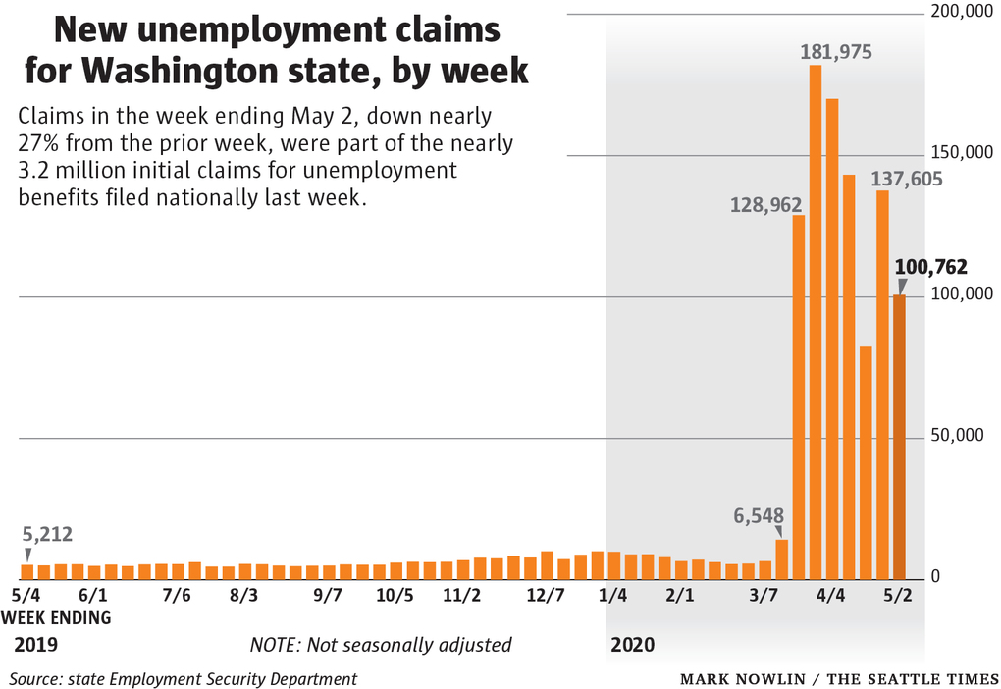
Many Expense Categories are Going Up
OTHER AREAS OF RISING EXPENSE: Public Health (the Pandemic Response), Mental Health, Social Safety Net Programs, Job Retraining, Unemployment Benefit Fraud Scam, Etc.

Slide 8
Washington State Budget Composition
MOST AREAS OF TAX = REGRESSIVE
Sources: Washington State Office of Financial Management, Conference Report for ESSB 6118

Slide 9
Pending Special Session
Inslee Will Likely Call the Legislature Into Special Session to Address Budget Crisis
30-Day Session(s)
Andy Billig (D): “As we continue preparation for an eventual special session and the 2021 regular session, we must take a balanced approach that includes budget savings and the use of resources like the budget stabilization account and, potentially, new revenue.”
John Braun (R): “The focus needs to be on letting go of new programs this month, before they start, in favor of maintaining the programs already in place. Today’s forecast affirms the need to take action now.”

Slide 10
Agenda
Budget Crisis in Olympia
Conceptual Framework
Spending Cuts
Raising Taxes
Summary

Slide 11
STATE DEFICIT: APPARENT OPTIONS
CUT SPENDING
RAISE REVENUES
AUSTERITY
NEW TAXATION

Slide 12
STATE DEFICIT: ACTUAL OPTIONS
GROW ECONOMY
RESERVES
LOCAL FUNDING
PRIVATIZE GOVERNMENT SERVICES
ISSUE BONDS
STATE BANK
REPEAL STATE TAX LIMITS
REPEAL CORPORATE TAX BREAKS
CHARGE MORE FOR FEES, LICENSES, PERMITS, ETC.
*NEW TAXES*
HIRING FREEZE, PAY CUTS, FURLOUGHS (INCLUDING REOPENING UNION CONTRACTS)
DELAY SPENDING PROGRAMS
*SPENDING CUTS*
FEDERAL GOVERNMENT SPENDING PROGRAMS
FEDERAL RESERVE

Slide 13
Agenda
Budget Crisis in Olympia
Conceptual Framework
Spending Cuts
Raising Taxes
Summary

Slide 14
ACTIONS ALREADY TAKEN
PROGRAM CUTS
Inslee in April, 2020: Over 147 -- $445 Million
SALARY CUTS, ETC.
Inslee in June, 2020: Pay Increase Rescission; Mandatory Furlough Days, IT Project Delays, etc.
15% BUDGET CUT PLAN REQUESTED FROM ALL DEPARTMENTS
Office of Financial Management
“This is a budget cut drill.” – David Schumacher, Director OFM
NOTE: THIS CHALLENGE WILL LIKELY ENDURE
“We are taking steps now to reduce spending. But we know we have enormous fiscal challenges ahead of us over the next few years.” – David Schumacher, Director OFM

Slide 15
Examples of Budget Cuts Being Discussed
University Tuition Increases
Cutting Day Care for Families in Poverty
Foster Care
Temporary Assistance for Needy Families (TANF)
Plans for K-12 Special Education and Wraparound Services
State Crime Lab
Policing Budgets
Other

Slide 16
Areas of Potential Restructuring
K-12: Use Blended Model (Half-Time in Class; Half-Time Online)
Lower population densities during pandemic
Reduce maintenance, food service, busing costs.
Teacher reductions?
Health Care: Move to Single Payer Model
Universal Coverage with lower administrative costs and better outcomes.
Mental Health: Accelerate Move from Centralized to Community Model
Close large facilities.
Higher Education: Use Blended Model
Close some facilities.
Market Online Lessons to Broader Audience (Economies of Scale and Added Revenue)
Etc.

Slide 17
Budget Cuts: Principles
Minimize Budget Cuts
Will Jeapordize Economic Recovery
Will Damage Low-Income and Minority Communities: “The victims of these cuts are the least amongst us. They are the most vulnerable people.” – Jay Inslee
Raise Revenues Via New Taxation To Minimize Required Cuts (Next Section)
Utilize Structural Means of Dealing with the Budget
E.G., Rainy Day Fund
Prioritize Salary Freezes and Furloughs Over Program Cuts
Delay Programs Rather Than Eliminate Them
Explore Opportunities to Restructure Certain Services to Save Money
Strategic Cuts, Not Across The Board Cuts
Do Not Make Cuts that Impact Future Outcomes
E.G., Early Learning Programs
Do Not Make Cuts that Exacerbate Key Objectives
Income Inequality, Racial Justice, Climate Change, Etc.

Slide 18
Agenda
Budget Crisis in Olympia
Conceptual Framework
Spending Cuts
Raising Taxes
Summary

Slide 19
Austerity
Paul Krugman, The Austerity Delusion (4/29/15)
“Meanwhile, all of the economic research that allegedly supported the austerity push has been discredited… It is rare, in the history of economic thought, for debates to get resolved this decisively. The austerian ideology that dominated elite discourse five years ago has collapsed, to the point where hardly anyone still believes it.”
The Republican Tax Narrative Fallacy
John Braun touts state’s ‘strong’ economy, says, “there’s no need to increase taxes.” --The Columbian (3/20/19)
“A struggling economy is no time to raise taxes” -- Kris Johnson, President of Association of Washington Business. -- Sequim Gazette (6/17/20)

Slide 20
Washington State: Tax Policy
Sources: Washington State Office of Financial Management; Institute for Tax and Economic Policy, 2018

Slide 21
Tax Reform Proposals Underway
Washington State: Frank Chopp (D 43rd)
Progressive Priorities and Progressive Revenues Plan
Capital Gains Tax, Payroll Tax, Tax on Large Corporations
“We can’t simply cut our way out of a recession…It’s better to invest in our people and lay the groundwork for the economy and people in the future…It’s not good that we didn’t have that equipment during this pandemic…We shouldn’t make that mistake again.” – Frank Chopp, 6/10/20
Seattle:
Sawant-Morales and Mosqueda Proposals for Tax on Large Corporations
Andrew Lewis Proposal for Capital Gains Tax on Wealthy Individuals

Slide 22
Agenda
Budget Crisis in Olympia
Framework
Spending Cuts
Raising Taxes
Summary

Slide 23
Principles for Balancing the Budget
First Priority: Growing the Economy
Social Distancing/Testing/Contact Tracing Key
Second Priority: A New Source of Progressive Revenue
Third Priority: Pursue Structural Opportunities
Rainy Day Fund, Corporate Tax Breaks, Federal Government, Relax Restrictions, etc.
Fourth Priority: Restructuring Select Operations is Key
Fifth Priority: Spending Reductions That Don’t Involve Program Cuts
E.G., Hiring freezes, pay freezes, mandatory furloughs, program delays
Sixth Priority: Prioritized Spending Cuts
Protect Vulnerable
Don’t Sabotage Future
Be Consistent with Societal Restructuring Priorities – Prepare for the Future

Slide 24
Themes
Budget Crisis is an Opportunity to be Engaged, Not Merely a Problem to Be Solved
Restructure Operations
Protect the Most Vulnerable
Have Budget Reflect Longer Term Societal Needs
A Visionary, New-Revenue Based Budget; Not Austerity
Reflect Short Term Fiscal Needs But Also Longer Term Goals
Bold Structural Change Is Needed; Not Just Incremental Reform
The Special Sessions Should Start Now and Be Broad in Scope

